Slide 1
Writing Equations of Trigonometric Graphs

Slide 2
Transformations
When writing an equation for a graph, you must recall the general form of the equations:
$a$ – indicates the stretch factor/amplitude (and vertical reflection if negative)
$b$ – indicates a change in the period
$h$ – indicates the phase (horizontal) shift
$k$ – indicates the vertical shift
$$f\left(x\right)=a∙fnct b\left(x−h\right)+k$$

Slide 3
Writing the Equations of Sinusoids
Writing the equations of either a sine or a cosine function is very similar.
You can ALWAYS write a wave as either function.
Sometimes it is easier to write the equation of a wave as one rather than another depending on what aspects of the graph you can pick out.

Slide 4
Sines vs. Cosines
Sine
Cosine
Usually you would choose to write a sine function if,
You can easily pick out the coordinates for a “zero” of the graph
Remember a “zero” is where the graph will cross the sinusoidal axis
Usually you would choose to write a cosine function if,
You can pick out the coordinates for a maximum or a minimum
Remember if you choose a minimum to make it a reflection

Slide 5
Writing the Equation of Sine and Cosine
Find the maximum and minimum y-values
Average them to determine the sinusoidal axis
This number is k
Sketch in the sinusoidal axis if it is not the x-axis
Determine the amplitude (distance from sinusoidal axis to max/min)
This number is a
(remember that if you go down first or start at a minimum that a is negative)

Slide 6
Writing the Equation of Sine and Cosine
Find a first “good” initial point
I usually choose the closest one to the y-axis (whether it is left or right)
Determine direction and x-value of this point
This is your phase shift (this is h)
Find the point that is at the end of one cycle
Determine the distance from your initial point
Set this distance equal to 2π/b and solve for b

Slide 7
Write the Function as both a Sine and Cosine
Vertical Shift = 0
Sinusoidal Axis = x-axis
K = 0
Period = π
2π/b = π
B = 2
Sine Function
Start at π/4 because it is the first “zero” that goes up
So, h = π/4
y = 3sin 2(x - π/4)
Cosine Function
Start at π/2 because it is the first maximum
So, h = π/2
y = 3cos 2(x - π/2)
Distance from sinusoidal axis to Maximum is 3
Amplitude = A = 3
3
$$\frac{5π}{4}−\frac{π}{4}=π$$

Slide 8
Write the Function as both a Sine and Cosine
Vertical Shift = 1
Sinusoidal Axis is y=1
K = 1
Period = 4π
2π/b = 4π
B = 1/2
Sine Function
Start at π because it is the first “zero” that goes up
So, h = π
y = 2sin (1/2)(x - π)+1
Cosine Function
Start at 2π because it is the first maximum
So, h = 2π
y = 2cos (1/2)(x - 2π)+1
Distance from sinusoidal axis to Maximum is 2
Amplitude = A = 2
Start here for cosine because it is the first maximum…
2
$$Half the wave=π−(−π)=2π$$
Start here for sine because it is the first “zero” that goes up…

Slide 9
Tangents and Cotangents
Tangent
Cotangent
Begins with a “zero”
Normal Period is π
Goes UP from left to right
Is a reflection and translation from Cotangent
Begins with an asymptote
Normal Period is π
Goes DOWN from left to right
Is a reflection and translation from Tangent

Slide 10
Writing the Equation of (Co-)Tangents
Determine (visually) if there is a vertical shift
See if the point of inflection is on the x-axis or at another value
This value is k (0 for the x-axis)
Sketch in the sinusoidal axis if it is not the x-axis
Sketch in the asymptotes
Determine the stretch factor (distance from sinusoidal axis to “half-way” points)
This number is a
(remember to think about which function you are using and if a should be negative)

Slide 11
Writing the Equation of (Co-)Tangent
Find a first “good” initial point/asymptote (depends on which function)
I usually choose the one closest to the y-axis (whether it is left or right)
Determine direction and x-value of this point
This is your phase shift (this is h)
Find the next point/asymptote (this is the end of one cycle)
Determine the distance from your initial point
Set this distance equal to π/b and solve for b

Slide 12
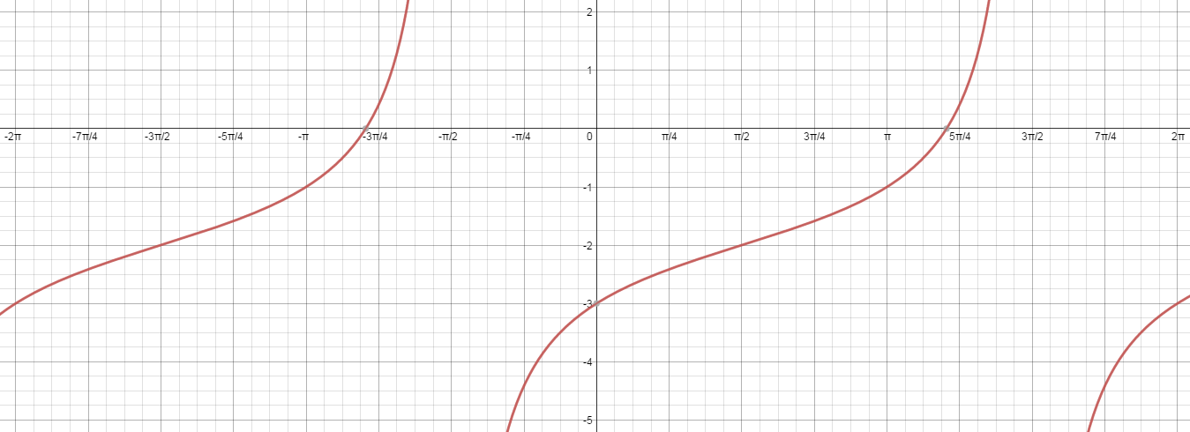
Write the Function as both a Tangent and Cotangent
Vertical Shift = -2
Sinusoidal Axis is y=-2
K = -2
Period = 2π
π/b = 2π
B = 1/2
Tangent Function
Start at π/2 because it is the first “zero”
So, h = π/2
y = tan (1/2)(x – π22)-2
Cotangent Function
Start at 3π/2 because it is the first asymptote
So, h = 3π/2
y = -cot (1/2)(x - 3π/2)-2
Distance from axis = 1
A = 1
Period = 3π/2-(-π/2) = 2π
A=1
Half way to asymptote

Slide 13
Writing the Equation of (Co-)Secants
Sketch in the related wave (reciprocal function)
Find the locations of all of the asymptotes and max/mins
Use the asymptotes to mark the zeros for the reciprocal function
Use the max/mins to mark the max/mins of the reciprocal function
Find the equation of the sine or cosine
Re-write as the cosecant or secant

Slide 14
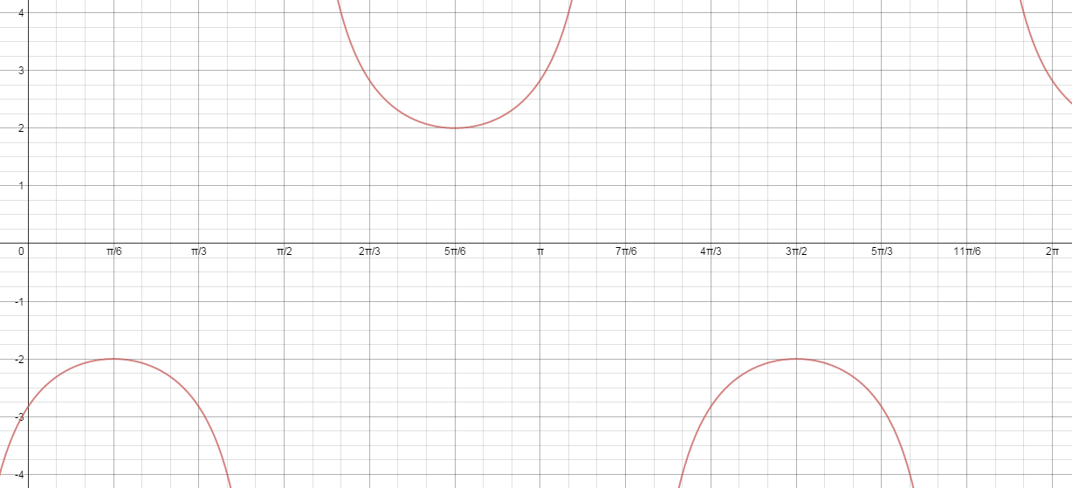
Write the Function as both a Secant and Cosecant
Vertical Shift = 0
Sinusoidal Axis is y=0
K = 0
Period = 2π
2π/b = 4π/3
B = 3/2
Cosecant Function
Start at π/2 because it is the first “zero” that goes “Up”
So, h = π/2
y = 2csc(3/2)(x – π22)
Secant Function
Start at 5π/6 because it is the first maximum
So, h = 5π/6
y = 2cos (3/2)(x - 5π/6)
Distance from axis = 2
A = 2

