Slide 1
Evaluating Inverse Trig Expressions

Slide 2
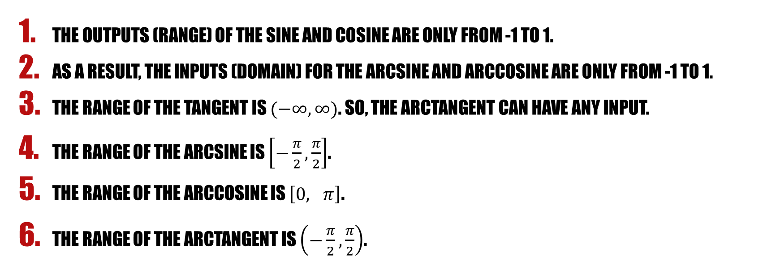
Things you must remember!
The outputs (range) of the sine and cosine are only from -1 to 1.
As a result, the inputs (domain) for the arcsine and arccosine are only from -1 to 1.
The range of the tangent is $(−∞, ∞)$. So, the arctangent can have any input.
The range of the arcsine is $\left[−\frac{π}{2}, \frac{π}{2}\right]$.
The range of the arccosine is $\left[0, π\right]$.
The range of the arctangent is $\left(−\frac{π}{2}, \frac{π}{2}\right)$.
THIS MEANS THAT THE ONLY ANSWERS YOU CAN GET ARE IN THOSE RANGES!!!

Slide 3
FINDING THE VALUES OF INVERSE TRIG EXPRESSIONS
Ask yourself the backwards question:
“ Where on the unit circle is the (sin/cos/tan) equal to this value?”
Which of these values that you came up with fit in the range of the arc-function?
Usually, there are two places on the unit circle where that value occurs for that specific Trig function.
Now… what is the answer?

Slide 4
EXAMPLES

Slide 5
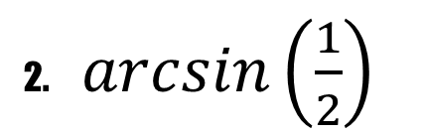
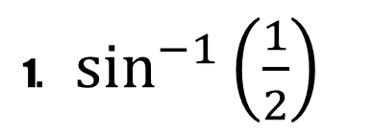
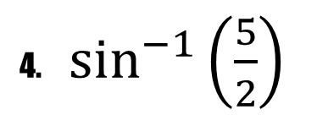
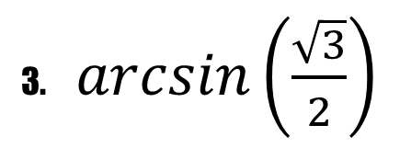
Evaluate each function. Use radians for your answers when appropriate.
1. $\sin^{−1}\left(\frac{1}{2}\right)$
3. $\arcsin\left(\frac{\sqrt{3}}{2}\right)$
2. $\arcsin\left(\frac{1}{2}\right)$
4. $\sin^{−1}\left(\frac{5}{2}\right)$

Slide 6
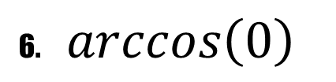
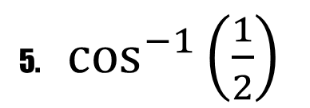
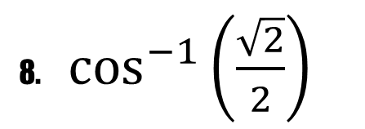
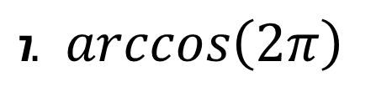
Evaluate each function. Use radians for your answers when appropriate.
5. $\cos^{−1}\left(\frac{1}{2}\right)$
7. $\arccos\left(2π\right)$
6. $\arccos\left(0\right)$
8. $\cos^{−1}\left(\frac{\sqrt{2}}{2}\right)$

Slide 7
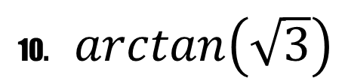
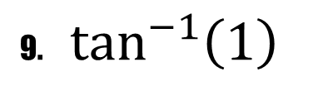
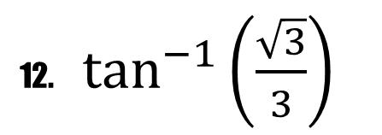

(HINT: For tangent, think about the fact that it is sine over cosine.)
9. $\tan^{−1}\left(1\right)$
11. $\arctan\left(−1\right)$
10. $\arctan\left(\sqrt{3}\right)$
12. $\tan^{−1}\left(\frac{\sqrt{3}}{3}\right)$

Slide 8
assignment
Worksheet: Assignment 9 #1-18 only

